Slide 1
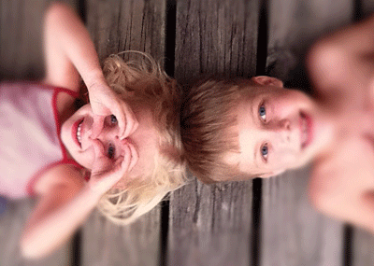
Communication Strategies
Effective communication
Sammy Fugler
November 2018
Updated November 2021

Slide 2
Aim of the workshop
Choose appropriate language which is developmental
Become more reflective of how we use language and it’s impact
To understand how language and communication are connected, and important for development

Slide 3
Feedback from the quiz…

Slide 4
Communication with children
Powerful
The core of our work
Basis for child development and management of the gan day

Slide 5
Think of something you wont share!
Sharing is HARD!

Slide 6
Work in pairs
What are the five top tips you have for effective communication with children?
7 minutes
Be ready to present your ideas
Be original!

Slide 8
Effective communication strategies

Slide 9
#1: At Rainbow we talk Early and Often
Start meaningful conversations at a very young age. Make talking with the children a habit you both enjoy.

Slide 10
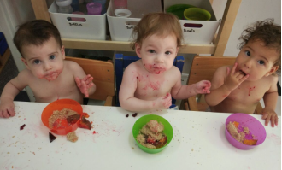
#2: Initiate the Conversation
Don’t wait for your children to start talking to you. Many times they won’t or don’t want to,
so get things started yourself.
Snack and lunch time provides a very rich language opportunity for staff to share and engage with children

Slide 11
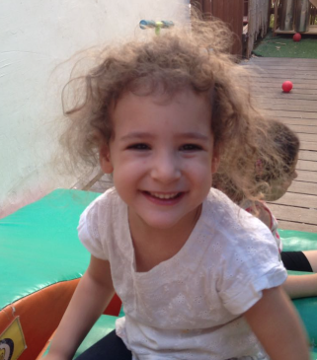
#3: Give children time
Listen to your children and let them speak.
The 10 second rule suggests that you should wait 10 seconds before you prompt again looking for an answer. This is the children’s processing time.

Slide 12
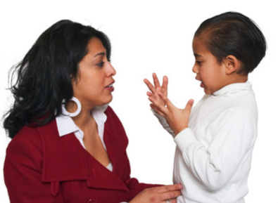
#4: Undivided Attention
We are busy, but you have to take the time to really listen to your children. Make them feel like you’re fully engrossed in what they’re saying.

Slide 13
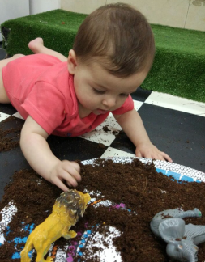
#5: Provide commentary
Provide a commentary and talk to the children about what is happening, especially at times of transition and nappy time.

Slide 14
#6: Schedule Time to Talk
Always make sure there is time to talk when you can really pay attention to one another. 1:1 and in a group.

Slide 15
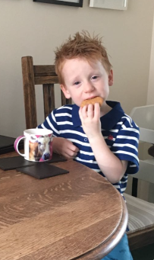
#7: Tell the Truth
How do babies get out?
Usually through the vagina…
Honesty is the best form of communication. When topics crop up which may make you feel uncomfortable, or you’re not really sure how to respond; honest and simple answers are best.

Slide 16
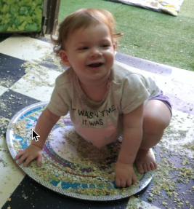
#8: Don’t Interrupt
Always let your children finish what they have to say. Make them feel listened to and understood.
Children don’t only communicate with words, listen to their behaviour

Slide 17
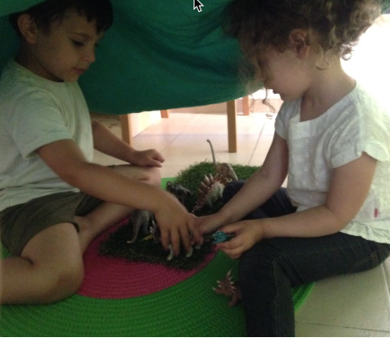
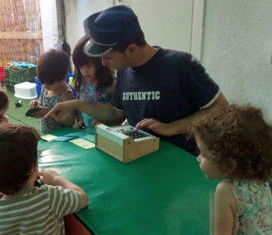
#9: Use language in different contexts
Use puppets, role play, circle time, outside time, story time to draw on different vocabulary and use different kinds of linguistic registers

Slide 18
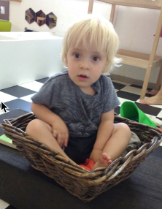
#10: Praise Them
Encourage your children through praise. When they deserve recognition, always provide it.
Be specific when praising

Slide 19
Work in your allocated language

Slide 20
Speak slowly and clearly

Slide 22
Use positive language

Slide 23
Avoid ‘nagging’ – be clear and positive with children

Slide 24
Emphasie the desired behaviour | Avoid nagging

Slide 26
Make sure that children know what they are doing / what their options are
Everyone tidy up
Stop that! Do something sensible!
Play nicely out here for 10 minutes
Just wait!
Choose something to do…

Slide 27
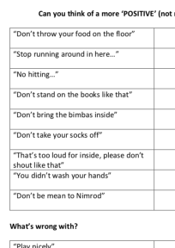
Your Turn!

Slide 28
Lets Practice!
What’s the right thing to say?

Slide 29
Don’t bring the scooter in here!
That’s an outside toy. Take it back out please. Now.

Slide 30
Its too loud in here, stop shouting…
Lets use our inside voices.
Ori… more quietly please!

Slide 31
Oooof! How many times, don’t push the others like that
Dvir, use your gentle hands please with your friends.

Slide 32
Don’t pick that up from the table. I already said, its not ready!!
Come and help me set up, that will be ready for play very soon!

Slide 33
No biting!
No biting!!

Slide 34
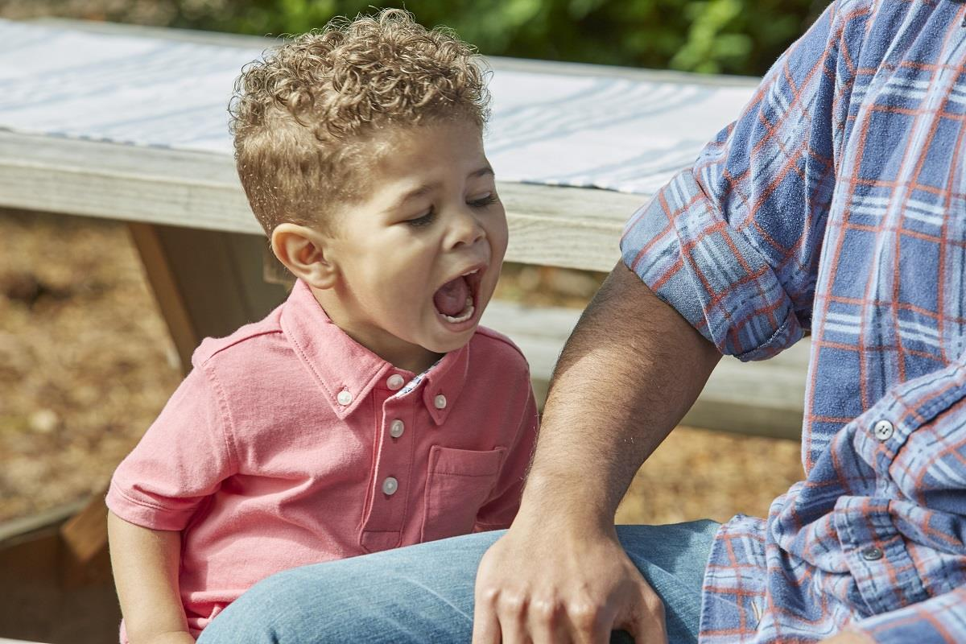
Why do children bite?
Jealous,
impulsive,
protective so uses it as self defence,
lacking skills like limited vocab,
seeking control,
frustrated too little to play with,
overwhelmed -too many other children and not getting attention,
imitating,
stressed (possibly from home not kindergarten),
In the habit and has been allowed to get away with it

Slide 35
Responding to biting:
Step in ASAP and also watch for frustrations building up
Centre attention on victim
Help child to replace biting with words
Help biting child to be kind -help the victim, play with showing sympathy to dolls/ animals/ other children
Use games which involve being confident and using a strong voice for children using biting in self defence (because bully won’t give them what they want)
Praise them when they have self control
Cool them down with water play, popsicles, blowing bubbles, playing with blowing windmill sticks, play dough

Slide 36
Reduce transition times when moving children around the building
Play cause and effect type of activities
Don’t just teach them to say I’m sorry as they might think they can say it and then it’s all OK.

Slide 37
Focus on desired and not undesired behaviour
State what you WANT the child to do…. Rather than commenting on what you do NOT want the child to do
Instead of…

Slide 38
Praise quickly and consistently. Make sure children understand WHY you’re praising them
It was lovely that you helped Jilli settle when she came in this morning!
Good job!
I can see you have got really messy – well done for taking part so well!
Thank you for letting Eddie go first with the scissors, great sharing!
Wow! Great

Slide 39
Positive behaviour
Co-operating with each other
Encouraging each other
Helping others
Asserting oneself
Full involvement in a chosen activity
Taking on new challenges
Showing empathy
Taking responsibility
Sharing

Slide 40
Encouraging positive behaviour
Clear rules
listen to and observe what children communicate both verbally and non-verbally;
praise and respond appropriately to all forms of children's positive behaviour
promote and reinforce positive behaviour by example;

Slide 41
Look out for ‘good’ behaviour (catch them being ‘good!)

Slide 42
Your Turn!

Slide 43
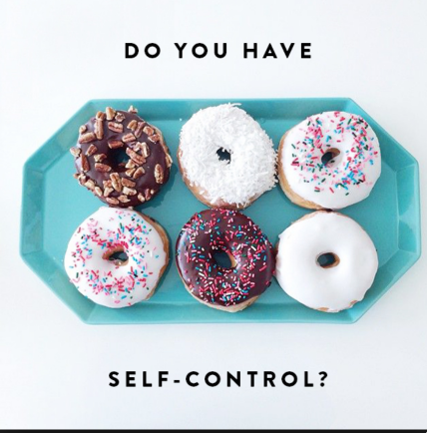

Slide 45
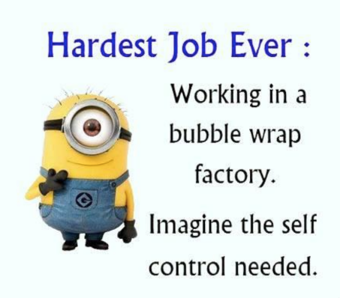

Slide 47
Tips and thoughts for developing self-control
Children learn emotional regulation from our modeling
Children take their cues about anxiety from the adults and peers around them
Every time we set a limit that the child accepts, they are practicing self-control (three more, and then its Romi’s turn)
Punishment doesn't encourage self-discipline because the child isn't actually choosing to stop; they are being forced

Slide 48
In the baby unit…
When Shira climbs too high, gets frightened, and wants to come down, how do you respond? If you can "guide" her down, talking soothingly so she can stay calm, you're teaching self-control. She's creating the brain pathways to talk herself through difficult situations in the future. But if you let her anxiety rattle you so that you swoop in to grab her down, she not only learns that she's incompetent, but that anxiety can't be tolerated, so she has to rush in and take action, rather than regulating herself to make rational decisions. That rushing tendency comes from anxiety and sabotages the building of the neural pathways she needs to stay calm.

Slide 49
In the Toddler unit…
Toddlers don't have the ability to resist a treat left available to them, while 30% of four year olds and virtually all adults do. What makes the difference? The prefrontal cortex, which is barely developed in a two year old and reaches maturity around the age of 25. How do you strengthen the prefrontal cortex? Practice! Some people have theorized that children who are "smarter" are the ones who are able to wait. But "smartness" is not static, and it is not just innate ability. It depends on being able to control your anxiety and your impulses, which we know is strengthened every time the child CHOOSES to do so.

Slide 50
Talk clearly, simply, and often about behaviours that matter
Take turns with the bimbas
Now is the time to listen and follow directions
Being helpful can make you and others feel happy
Reading time is quiet time
Keep rules and expectations simple, and remind children often when it’s time to follow them

Slide 51
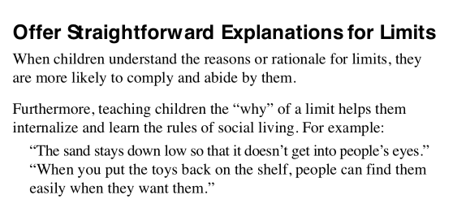

Slide 52
Provide choices
Providing choices is also a valid prevention strategy for children, which often avoids power struggles
Can you think of some choices you could offer?

Slide 53
Children making choices
The process of learning self-control and self-discipline is linked closely with how a child feels about themselves and their relationship with the world. Its our role to help build and strengthen children’s ability to determine for themselves what is right and what is wrong, and how to control their own behaviour.

Slide 54
Model problem solving skills
Did you ask for it back?
Is there another one you can use?
What else could you do?
What could you say to him?
Shall we look for it?
As children loose control lets offer them assistance to help them solve their problems

Slide 55
Provide opportunities for children to make amends
Avoid asking children to say ‘sorry’

Slide 56
Summarise how you dealt with the problem, this will support them for ‘next time’

Slide 57
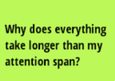
Realistic expectations | Attention span
Acknowledge that young children have limited attention spans by alternating learning activities that require quiet, focused attention with opportunities for independent play and learning activities that include movement.

Slide 58
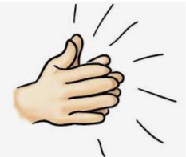
Gain attention respectfully

Slide 59
Call to attention
The ability to focus attention is a crucial executive function for success. Newborns are drawn to the stimulus that is most noticeable in their environment. In the course of normal development, infants begin focusing their attention on specific stimuli emphasised by adults

Slide 60
Do not share your screens with the children!
Stream music to a speaker
Visit Elephants to views educational clips on their computers

