Slide 1
Staff Meeting
25th September 2016

Slide 3
What is…

Slide 4
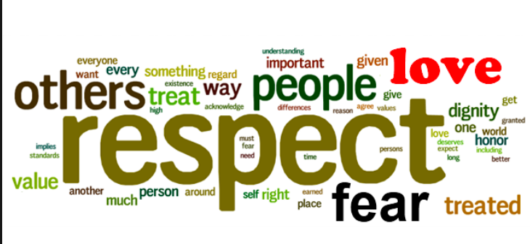

Slide 5
Respect means…
…to demonstrate "high regard" for or special attention to someone

Slide 8
What are….

Slide 10
Respectfulness
Listen to what children are communicating to you
Keep rules simple and easy to understand
Say what you mean (use “do” instead of “don’t”)
Talk with children rather than at children
Keep your pitch calm and your voice low, speech slow
Comfort and support children with warmth and physical contact
Meaningfully engage children, avoid leaving them ‘lost’
Set a good example – let them see how YOU deal with anger, frustration
Treat each child as an individual (not one of a group)
Avoid a ‘conveyor belt’ approach

Slide 11
Things to think about…
addressing every child with respect; never referring to or about them as if they are not there as if they are a piece of equipment
involving the children in conversation; never talking about children as if they were not there
respecting every child’s privacy at all times and in all places
treating all information about children carefully, keeping it safe and sharing it only with those people who need to know
involving children in decisions that affect them: actively encouraging children to express their views and where these cannot be taken into account, then explaining why
giving opportunities for the children to make their own choices

Slide 14
Respect
How can we do this consistently in every interaction?

