Slide 1

Staff Meeting
15th March 2016

Slide 2
Welcome
Quick Introductions
Review of Language game
Update
Split into groups
  Daily jobs and tasks
  Dan Plan
  Targets for the children

Slide 3
It’s a great idea to always have music in the background
False

Slide 4
Correcting a child when they get language in the wrong order is the best way to support language development
False

Slide 5
Singing songs in other languages (not Hebrew or English) is unhelpful to support language development
False

Slide 6
Introducing hand signs is a bad idea as it could delay language as children will not need to speak to express themselves
False

Slide 7
Keeping a dummy in their mouths will not affect language development
False

Slide 8
Insisting that children make choices (which do you want a banana or an apple)… can stress children and impact negatively on language development
False

Slide 9
Modelling back language correctly when children get their words confused helps them self-correct
TRUE

Slide 10
Closed questions are better than open questions to help children who are beginning to speak
False

Slide 11
Open questions can leave too many possibilities for children and so inhibit their speech
False

Slide 12
Language development is not so important in baby unit, they are not yet capable of speaking
False

Slide 13
Constantly describing and narrating your actions and children’s actions is over-stimulation and not needed
False

Slide 14
Singing the same songs over and over again with children does not help language development as they will not learn new words
False

Slide 15
It’s a great idea to simplify language when talking to young children so they understand
False

Slide 16
If children are used to hearing only Hebrew at home it’s a good idea for English speakers to say some words or sentences in Hebrew so they understand (and visa versa)
False

Slide 17
THINK!
Volume
English | Hebrew (no mixing)
Developmentally appropriate language
Full sentences
LOTS of language in different contexts

Slide 18
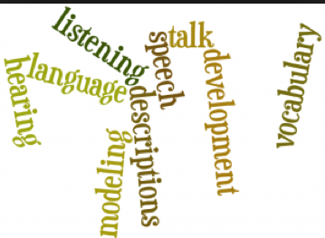
Language rich environment!

