Slide 1
EYFS @ Rainbow

Slide 2
Born ready…
Children are born ready, able and eager to learn. They actively reach out to interact with other people, and in the world around them. Development is not an automatic process, however. It depends on each unique child having opportunities to interact in positive relationships and enabling environments

Slide 3
4 principles

Slide 4
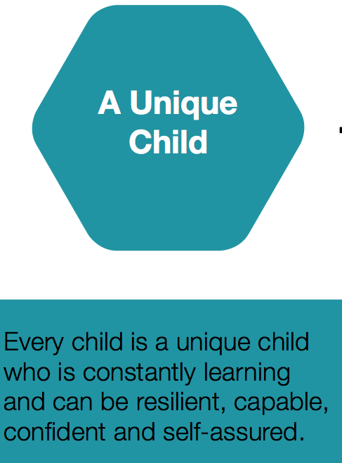

Slide 5
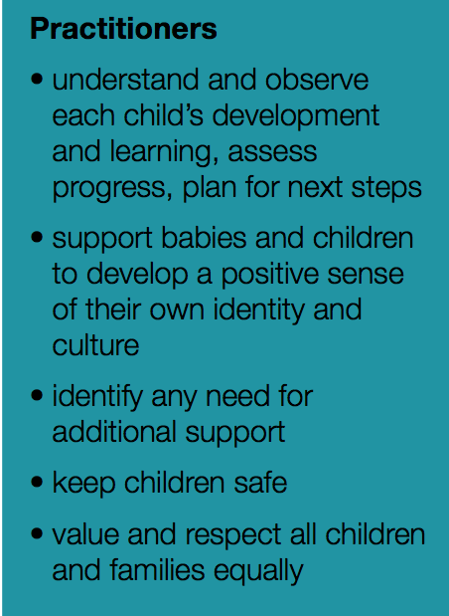

Slide 7
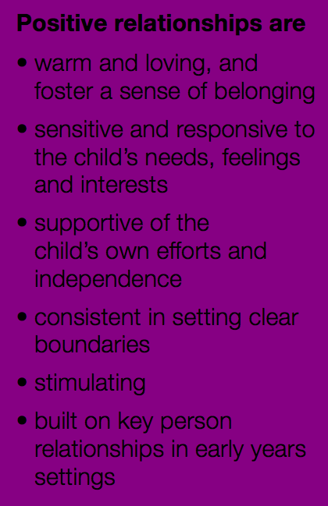

Slide 8
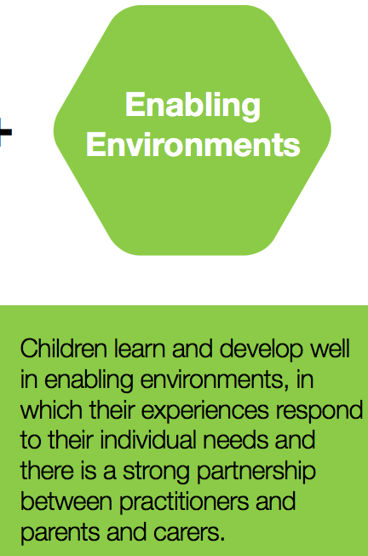

Slide 9
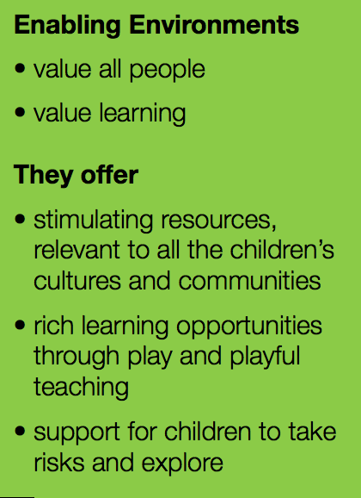

Slide 10
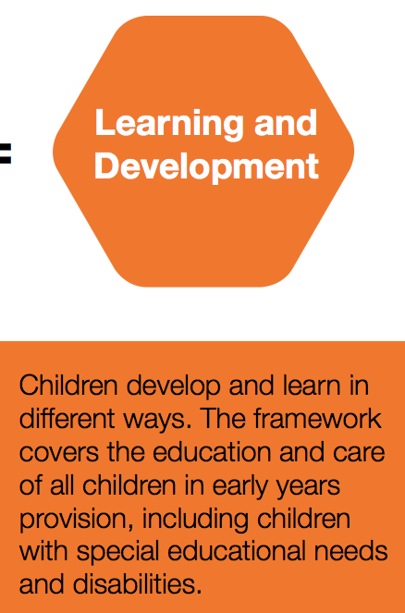

Slide 12
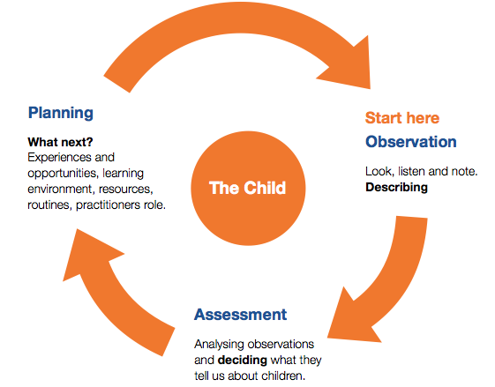

Slide 13
Formative assessment
Observe children as they act and interact in their play, everyday activities and planned activities, and learn from parents about what the child does at home (observation).
Consider the examples of development in the columns headed ‘Unique Child: observing what children can do’ to help identify where the child may be in their own developmental pathway (assessment).
Consider ways to support the child to strengthen and deepen their current learning and development, reflecting on guidance in columns headed ‘Positive Relationships’ and ‘Enabling Environments’ (planning). These columns contain some examples of what practitioners might do to support learning. Practitioners will develop many other approaches in response to the children with whom they work
Where appropriate, use the development statements to identify possible areas in which to challenge and extend the child’s current learning and development (planning).

Slide 14
Summative assessment
Identifying WHEN the milestones have been met
Termly (3 per year) meetings with parents to discuss children’s progress
Developmental Files
Observation each month
Example of achievement each month
Record of milestones
Record of parent meetings

Slide 15
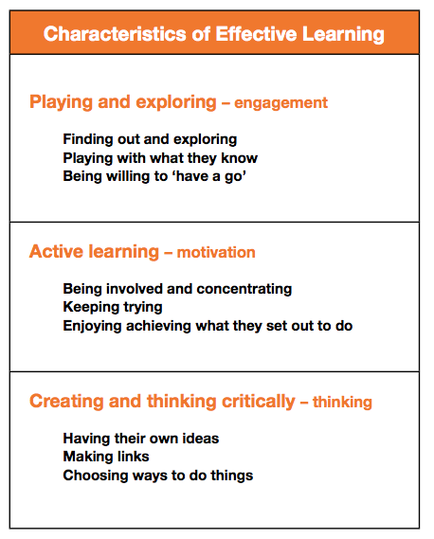
The Characteristics of Effective Learning

Slide 16
Areas of learning
There are now SEVEN areas of learning (previously 6)
However, these are now split between Primary Areas of learning and Specific Areas of learning

Slide 17
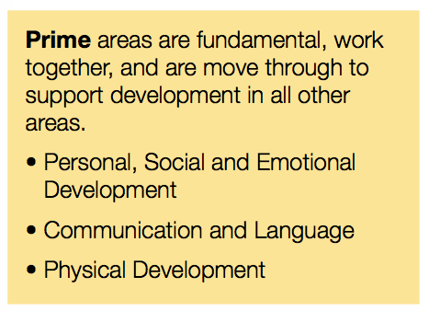
Prime Areas

Slide 18
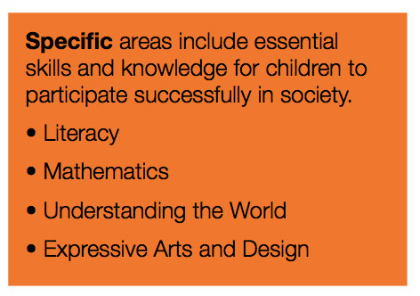
Specific Areas

Slide 19
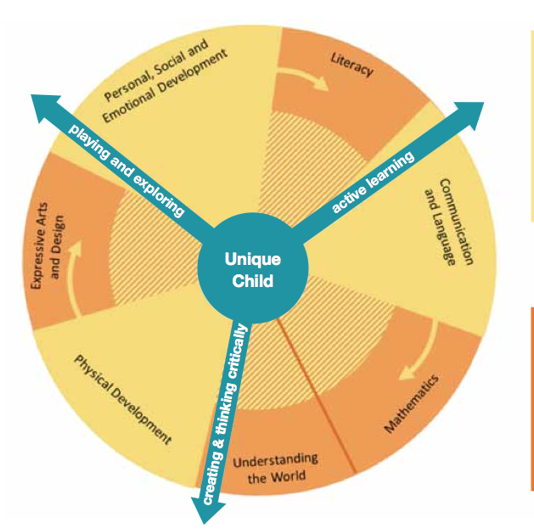

Slide 20
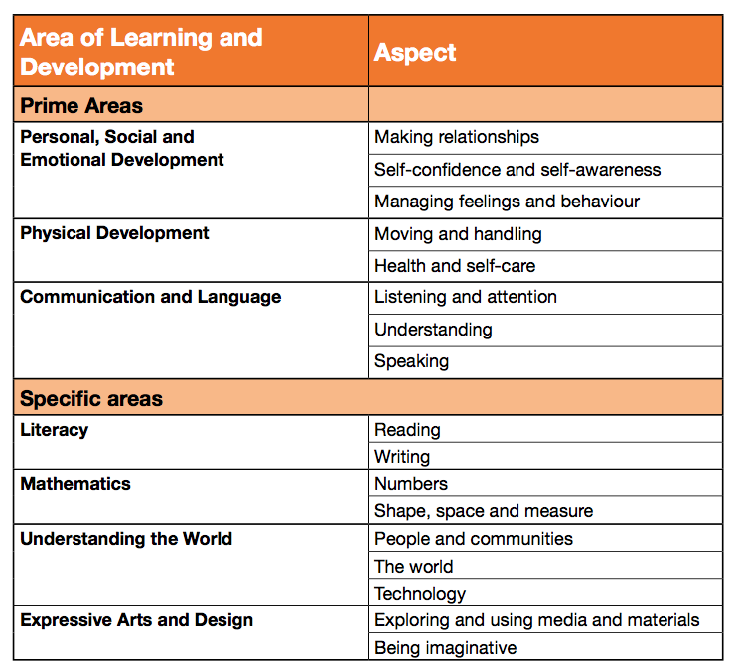

Slide 21
Milestones
The 17 aspects, which come from the 7 areas of learning are broken down into developmental milestones for each agegroup
For each aspect, for each agegroup, the guidance shows how we can support the child to achieve the milestones through our practice and how we organise the environment

Slide 22
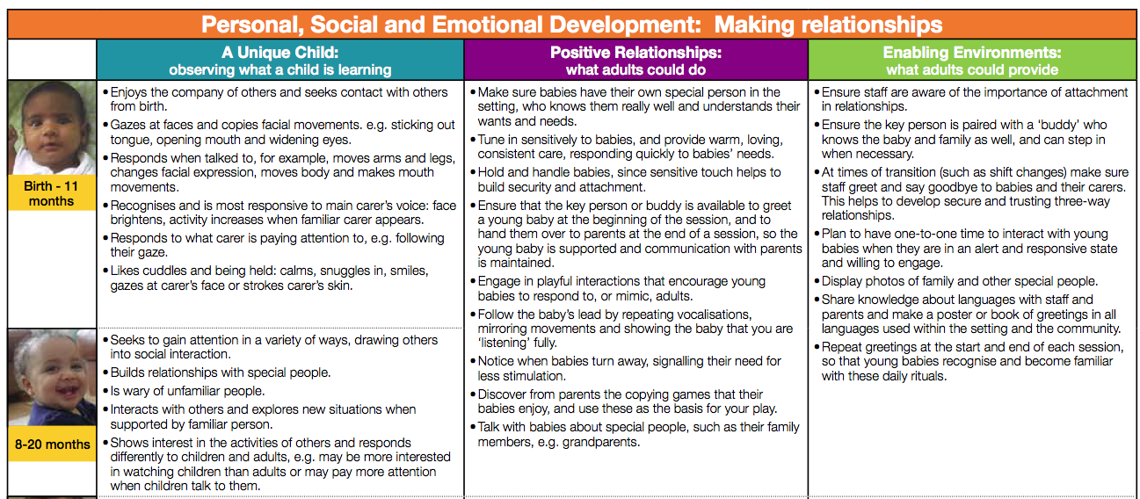
Lets take a look at the first aspect…

